Slide 1
SQL Security Principals 101
William Assaf,
He/Him,
Title,
Company

Slide 2
Explore PASS

Slide 4

William Assaf
Principal Consultant, Microsoft MVP, PASS Regional Mentor
He/Him
Title
Company
in/williamdassaf
@william_a_dba
SQLTact.com
Co-author, Microsoft Press, SQL Server Administration Inside Out 2017, 2019
Notes:
Information on me, I’ve spent the last 12 years as a consultant and most recently a principal consultant and leader a SQL Server consulting team, and only I the last few weeks have I accepted a position with Microosft on the SQL content development team.
Finally, throughout this presentation I may reference a script in a “toolbox”. Just for the low low price of attending this session, I’ve included a toolbox of SQL Server scripts to accompany this presentation. It’s available for download on the PASS Summit website accompanying this presentation.

Slide 5
Agenda
Authentication and Logins
Permissions
Operational Security
Database Object Security
Security Lightning Round
Notes:
Today we’re going to cover a lot of important foundational material about security, accounts, authentication. For folks new to SQL Server security design and administration, this will be a great foundation for your learning. For those experienced in SQL admin, this will be a thorough evaluation of what you know, or thought you know, and maybe some gaps in what you know. I think there is content in here to interest everyone in the SQL career lifecycle, and I’m not just guessing at that. I got my first DBA job in 2006. I’ve been giving a presentation on Security at User Groups and SQLSaturdays basics for years, it was one of the first topics I started speaking technically on a decade ago. As my own experience has deepened and broadened throughout my career, so has the content I build into this presentation. So I’m going to start basic, and build quickly from there, focusing my content around common hurdles and tasks that database administrators face, in the hopes of deepening or broadening your experience, as well.
This is session one of a four part Learning Pathway on security. In subsequent presentations over the next three days,
John Morehouse is presenting part two, Understanding Modern Data Encryption Offerings for SQL Server, including a lot more information on all the various sorts of encryption, plus some important security features of SQL Server like Transparent Data Encryption and Always encrypted.
Jeff Renz is presenting on Securing Your Data In Azure: Tips and Tricks, which covers Advanced Threat Detection, the Azure Key Vault, cloud secure connection strings, and certified data sets for security in PowerBI.
Ed Leighton-Dick will cap it off with a presentation on Building a Security Dashboard for SQL Server, talking about when certs expire and what does that actually mean, more on Azure Advanced Threat Detection, SQL Audit and monitoring.
But today we’re setting the stage for a good conversation around security at PASS Virtual Summit 2020, especially around how permissions behave inside each database, how you can design database security, the relationships between logins, users, and databases. We’re start first by introducing the way security things are normal configured, but we’ll also discuss weird ways they veer from the normal.

Slide 6
Section Title 3
Authentication and Logins

Slide 7
Principal vs Principle
Principal
(noun) a person who is in charge of some responsibility
Example: The principal consultant talked to the school’s principal.
(adj) original, most important
Example: The principal aim of a good DBA is to defeat wicked developers.
Principle
(noun) a rule, guideline or fact
Example: Our guiding principles are based on science.
Notes:
So this is a common grammar issue in the English language, the difference between principal, P-A-L and principle, P-L-E.
Both can be a noun, but PAL describes a person, a person who could be your “pal”. A principle PLE is an inanimate thing, like guiding principles, or being principled, a way to describe someone who follows a moral or ethical code.
So today, we’re really talking about both today. Principals, PAL, are not only what SQL Server calls security objects in the database, Principles, PLE, that guide how we as DBA’s should design and create securables in our servers and database.

Slide 8
A Principal’s Principles
We can all be Principled Principals
who follow Principal Principles of security.
Notes:
My title at my last consultant company was Principal Consultant, so this Principal is going to share with you his Security Principals.
You’ll see Principals, PAL, in

Slide 9
Why is Security Important?
Proper implementation of SQL security principals:
Decreases administrative effort
Decreases application complexity
Decreases database surface area

Slide 10
Login vs User
Database User
Server Login
Has a database context
Often linked to a Login*
Does not have a password*
Stored in a Database
Included in DB Restore
Given access to SELECT, UPDATE, EXECUTE, CREATE TABLE, etc.
*Most of the time. We’ll talk about it.
Connects to a SQL Instance
Linked to AD (Windows Auth)
or has a password (SQL Auth)
Stored in the Master database, so not in other DB restores
Given access to CONNECT, VIEW SERVER STATE, CREATE DATABASE, etc.

Slide 11
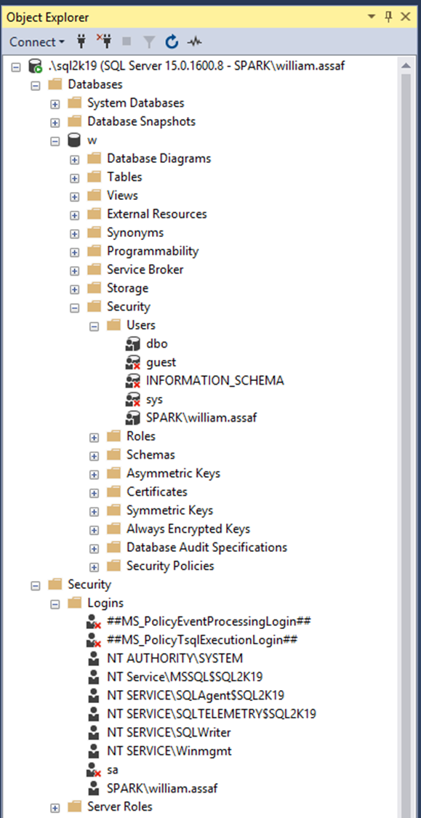
Login vs User
Database User
Server Login
Has a database context
Often linked to a Login*
Does not have a password*
Stored in a Database
Included in DB Restore
*Most of the time. We’ll talk about it.
Connects to a SQL Instance
Linked to AD (Windows Auth) or have a password (SQL Auth)
Stored in the Master database, so is not included in other DB restores
Notes:
Same info here, but we’re looking at object explorer in SQL Server Management Studio. …

Slide 12
AD Security Groups
Create logins for to AD Security Groups, not individuals. Insist on it.
Be aware of who is a member of those groups, and what groups are a member of groups, and what groups are a member of those groups…
Notes:
Devs -> App Support -> QA -> Financial Analysts…

Slide 13
AD Security Groups
You can interrogate AD for the members of security groups
EXEC master..xp_logininfo
@acctname = 'domain\groupname',
@option = 'members'
BUT it only returns FIRST level members, not recursive. Instead use PowerShell:
Get-ADGroupMember -identity 'Development' -recursive

Slide 14
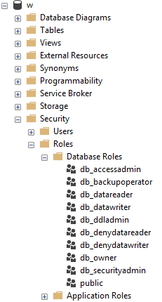
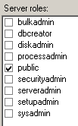
Server and Database Built-in Roles
Roles are security principals too
Logins added to Server Roles
Users added to Database Roles
Built-in Roles to provide a standard for access that may be too broad.
Follow principles of RBAC.
Notes:
<read slide first> RBAC is an acronym many in the governance area are familiar with, the idea that nobody gets permissions that are unique to them, they are only granted permissions based on their role, not their individual needs. Role Based Access Control means that creating specific permissions is a meaningful exercise, because it’ll be applied to members of a group. The last thing you want to end up with are many SQL Logins, each with their own permissions. This would make application maintenance and proper security auditing a nightmare. Instead, you should work with developers to identify permissions needed per role, and then create custom Server Role and/or Database roles to grant those permissions.
When granting permissions to a role, assign more specific permissions when possible. While you can add a role to the built-in database roles, like db_datareader or db_datawriter, that might be overreach. Your data within a database may not be homogenous in terms of sensitivity/permissions to access.
Later, we’ll talk about schemas, these are also security principals, and great way to grant more specific permissions than to all objects in a database.
Last on these sample images here, you’ll notice the public roles at both the server and database level, and how that server role public checkbox is always checked. And it can’t be unchecked. Let’s talk about public.

Slide 15
Public
Every login/user is a member of “public” roles.
All logins/users inherit permissions granted to public.
Public is a server role that should never be granted any additional permissions, authorization or ownership.
Public is also a database role. Every database user/role belongs to a public database role.
Notes:
<read notes instead>
Every login is a member of the public server role. Every user in each database is a member of the that database’s public database role.
Only very lazy and short-sighted developers would grant permissions to public, which allows every user that does or ever will exist, to inherit permissions.
Permissions assigned to the public role is a clear sign of lazy developers. Don’t be a lazy developer.

Slide 16
Public
Should fail any app security audit or DB audit. Trust me.
Expected non-issue findings from Database Diagram feature.
A pain to unravel.
Check for this.
Toolbox: 1 - public permissions.sql
Notes:
<read slide first>The strategy to undo a security architecture based around public can be complicated, involves lots of testing, almost certainly requires participation from the developers to figure out what permissions are actually needed.

Slide 17
Guest
Special built-in user in each database.
Any login that doesn’t have a mapped user in a database inherits GUEST.
By default, this is disabled in all databases.
Check for this.
Toolbox: 2 - guest permissions.sql
Notes:
<read slide first>
For what should be very obvious reasons, never grant any permissions, even CONNECT, to GUEST, unless you understand what you’re doing.
If a login doesn’t have a user in a database, it shouldn’t have access to the database.
Not a secure solution for future access. Similarly, this could also trip a SQL Server security audit failure.

Slide 18
Server Logins
Logins are given a default database.
CONNECT will fail if the Default Database is not accessible.
Best practice: set Default Database to the intended User Database, or to TempDB, which is always there, but not persistent.
Notes:
<read notes first>
Again, a SQL Server Login is a server-level security principal
A User is a database-level principal
<click>

Slide 19
Server Logins + Database Users
A Server Login is what authenticates a connection to SQL.
A Database User provides a Login with database access.
Notes:
<read slide first>
“Login” is a server level security principal.
“User” is a database level security principal.
Now, let’s talk about the different types of SQL Server Logins, they’re differentiated by how they authenticated to SQL Server.

Slide 20
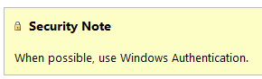
SQL Authenticated Logins
SQL Logins are authenticated by a SQL Server instance.
“Enforce Password Policy” encouraged, but not required!?
More administrative effort to maintain, migrate, secure.
Notes:
1. We’ll talk more about this but this means each SQL Server is now an authority for its own credentials. If you have 10 SQL Server instances, that 10 different sets of logins and passwords to maintain, as opposed to one Active Directory.
2. Strongly encouraged to Enforce password policy, which can include password expiration, inheriting from the same settings in Windows.
Unfortunately, the password policy is optional! Password could be password, empty string, or the same as the user name.
Also, if a login doesn’t currently have the password policy enforced, you can check the box, but it doesn’t apply to the current password. So it’s way too easy to mark a login to apply policy, but have a password that is NOT strong enough to meet policy. The policy would only then be checked if it is changed.
3. Multiple failed SQL auth login attempts will Lock Out, which a DBA must resolve. Because these credentials are specific to each instance, it also means that SQL logins must be kept synchronized, more or less manually, between replicas in an Availability group
Finally, see here a plain and clear screenshot from Microsoft Docs. Use Windows Auth when possible. Don’t even enable SQL Auth unless you have to – it’s not enabled by default when you go to install SQL Server. You have to go out of your way to configure the instance in Mixed Mode, which enables SQL Logins and allows the built-in “sa” account to be enabled.

Slide 21
SQL Auth Passwords
Check for weak or easily predicted passwords.
Compare hash results to sys.sql_logins.password_hash.
Toolbox – 3 easy passwords.sql
Notes:
<read notes> Let’s talk more about the optional password policy in SQL Server.
If you’re a sysadmin, you can perform what is essentially a rainbow attack against your own SQL Server to look for weak or easily predicted passwords. You can do this because SQL Server makes the one-way password hash function available to you. So you can run any string through the hashing function, then, compare the one-way hash to what SQL Server stores. So while you can’t reverse engineer or decrypt a password, you can generate a hash of any string, then compare hashes. And you can do all of this without failing a login attempt or locking out a login.

Slide 22
Windows Auth vs SQL Auth
In a typical enterprise business environment,
Windows Authentication means that:
account creation/termination,
security group membership,
password policy,
are all handled by an existing corporate security administration infrastructure.
Notes:
<read notes first>
So we’ve talked about how SQL auth really creates additional administrative overhead and the fragmentation of security for user and even application access. In comparison to Windows Authentication, specifically using Active Directory, SQL Authentication creates a decentralized security setup in each instance.
<click, read slide>
Centralizing account and password management, role assignment, these are good things to do from a governance standpoint and from the standpoint of, that thing you see on Certification Exams all the time? “Least amount of administrative effort”
Proper use of the Windows Authentication model creates Server Logins that are linked to Domain Accounts, Preferably linked to Security Groups in Active directory, not individuals, so that membership is also managed by your existing security infrastructure.
Windows Authenticated Logins can also be created for Local Windows users, local to the Windows Server. This isn’t ideal, creating some of the decentralization and redundancy issues common for SQL Authenticated logins. Don’t recommend them except for potential use in SQL Servers outside of a domain.
In any case, SQL Server inherits the password policy of the local Machine Policy, regardless of whether or not the local Machine Policy is inherited from a Domain Policy.

Slide 23
Windows Auth and Apps
Using Windows Auth requires the OS to authenticate.
In Windows, this is the SSPI, which will authenticate via Kerberos or NTLM. This is non-trivial.
Kerberos requires Service Principal Name (SPN).
NTLM = old MS Authentication protocol that Kerberos replaced.
If you get SSPI issues, it’s likely a double-hop or trust issue.
Use Service Accounts in all cases, SQL or Windows Auth.
Notes:
Now, to be fair, Windows Authentication does have a complexity increase.
<click>
<read slide bullet points 1-5>
<read notes>
You may have encountered this before if trying to use Windows Authentication from an Internet-facing server, like an App Server in a DMZ, or otherwise outside of the domain. Kerberos may be required to authenticate a Windows User directly from the application server to the SQL Server. Can increase the complexity of an application loadout, but this is the Enterprise approach. I don’t have time to do a deep dive on this today, but this is fairly well documented and may involve your Active Directory admins helping to configure.
<click>
This is why I still see SQL Authentication used by many applications, because developers don’t want to have to ship applications that depend on this kind of trust. To be clear, this is less secure.
The best way to design this is that applications that SQL Logins at least use a SQL Login that isn’t used interactively.
When I say interactively, I meant that no human is ever typing in this user name and password. Make the password painfully long, even.
Make sure that developers themselves don’t use the SQL Login, they should still use their own Windows Authentication, even if they are external vendors. A defining characteristic of a Service Account is that nobody knows its password, and at least, it isn’t used interactively.
We’ll talk about service accounts more later on, and especially the different options around Windows Authenticated Service Accounts.

Slide 24
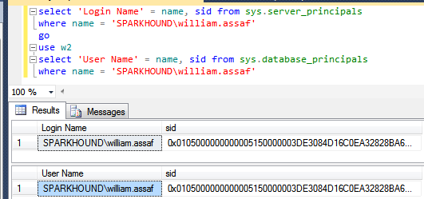
Logins + Users
A User can be linked to any Server Login
The names don’t actually have to match, but they should.
A SID (Security-IDentifier) is shared by User and Login.
Notes:
In Windows Authentication, that SID comes from the Windows provider, likely Active Directory. So in all SQL Servers where that domain account is used, it’s got the same SID.

Slide 25
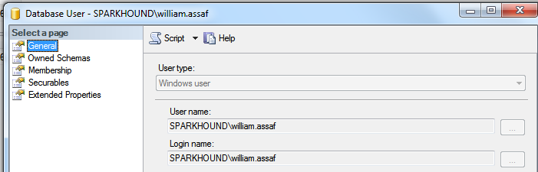
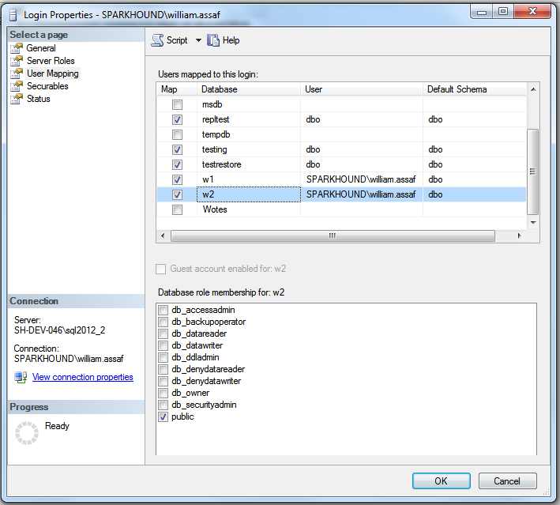
Login Mapping to Database User
Logins are mapped to Users in the User Mapping page of the Login properties dialog.
Notes:
It’s here in the mapping that users take on the SID of the login.
Note here also the user “dbo”, this is a special user in each database that sysadmins can use. We’ll talk more about dbo and its shifting uses over the years later on.

Slide 26
Orphaned SID
DB Users can be disconnected from their SQL Auth Login.
Commonly occurs when a database is restored from one SQL instance to another.
Only with SQL Auth Logins, not Windows Auth Logins.
SQL Auth Login = local SID, Windows Auth Login = AD SID
Notes:
<read slide>
Now, why is that? Why would this only affect SQL Authenticated Logins?
<click>
It’s because, unless you specify a SID yourself, the SID for a SQL Server is generated locally at each SQL instance. IF you got and create a Login named test on 5 different SQL server instances, you’ll get a Login named Test with five different SIDs. There is a way to create a SQL Auth Login with a pre-determined SID, this is how migrations happen, we’ll talk about this in a bit.
If you create a Windows Login for the same Active Directory account on five SQL instances, each Login has the same SID, because all five SQL instances got the SID from the same place, AD. Therefore any user associated with the Login will have the same SID, on any SQL instance. This is becomes incredibly important for Availability Groups, where is much simpler to distribute an Windows Login from AD to each replica, versus distributing a SQL Server authenticated login to each replica, scripting it out to use the same SID in each instance.

Slide 27
Fix Orphaned SID
To re-associate a database user to a server login:
ALTER USER username WITH LOGIN = loginname;
SELECT DBUser_Name = dp.name
, Login_Name = sp.name
FROM sys.database_principals AS dp
INNER JOIN sys.server_principals AS sp
ON dp.name = sp.name
WHERE sp.sid <> dp.sid
Toolbox: 4 – fix orphaned sid.sql
Notes:
Let’s say the login already exists, with two different SIDs, and we need to go ahead and repair the user, to link it back with its Login. The command is actually quite simple. You can also proactively identify orphaned logins by comparing their names and SID in SQL Server’s internal metadata.
<click>
Here’s the basic join, and there’s a script in this session’s toolbox that helps you quickly identify and repair orphaned SIDs. If you’re an experienced DBA, remembering to look for and fix orphaned SIDs is a necessary followup any time a database is restored from one server to another, for example, to update a dev or test environment from production.

Slide 28
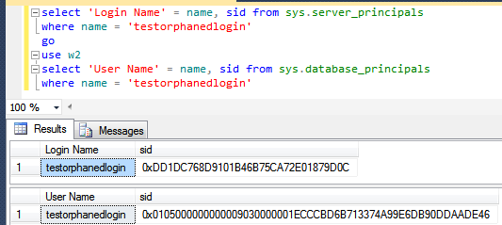
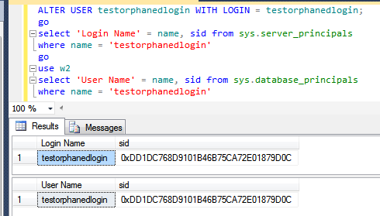
Fix Orphaned SID
Notes:
You’ll know you have a problem with an orphaned SID if the end user or application gets an error like this. “The server principal is not able to access the database under the current security context“, this is a symptom of a mismatched SID.
<click>
And here, we can verify in the system views that indeed, I’ve got a SQL authenticated login and a Database User of the same name, but different SIDs.
<click>
After running ALTER USER with LOGIN, you can see now that the Database User has been modified to reflect the SID of the login on this SQL instance.

Slide 29
SQL Auth Login Migration
Not possible to reverse-engineer a SQL Auth Login password.
Migration of SQL Logins is accomplished by:
Backup+restore of the master database (complicated) -OR-
Creating SQL Logins with same SID but new password (not desirable) -OR-
Generating a hash of the password and same SID (most desirable) Let’s go more into that….
Notes:
<read notes>Like we said earlier it is not possible to reverse-engineer a SQL Auth Login’s password, you can guess it an infinite number of times via the hashing algorithm we discussed earlier, but you can’t see it.
So when migrating SQL Logins from one instance to another during an upgrade or migration, you have options.
<click>
The first option involves restoring the master database, which is obviously only possible in a migration to the exact same SQL Server version. You may also find this more or less impossible if the drive letters are changing, so consider restoring the master database an important disaster recovery option in the event of a baremetal restore, but not an option for server upgrades.
<click>
Scripting out all SQL Logins with the same SID but a new password is possible, but breaks a lot of connection strings, and it’s unnecessary because,
<click>
We can generate that hash of the password, without knowing the password, and using that and the SID, can recreate a login on the other instance. This is easily scriptable. Let’s talk more about that.

Slide 30
SQL Auth Login Migration
Microsoft has provided a pair of sprocs to generate the hash of passwords: support.microsoft.com/kb/918992
sp_hexadecimal + sp_help_revlogin
But don’t forget to migrate the server-level permissions:
Toolbox: security Script servers.sql

Slide 31
SQL Auth Login Migration
Microsoft has provided a pair of sprocs to generate the hash of passwords: support.microsoft.com/kb/918992
sp_hexadecimal + sp_help_revlogin
Create both in master then EXEC sp_help_revlogin
But don’t forget to migrate the server-level permissions:
Toolbox: security Script servers.sql

Slide 32
SQL Auth Login Migration
Microsoft has provided a pair of sprocs to generate the hash of passwords: support.microsoft.com/kb/918992
sp_hexadecimal + sp_help_revlogin
Create both in master then EXEC sp_help_revlogin

Slide 33
SQL Auth Login Migration
Migrating a SQL Login with its password and SID is critical.
Regular proactive check for all replicas in availability groups:
Check that all Logins exist AND All SQL Logins have same SID, hash
Notes:
<read slide first>
This is also important for setting up new Availability Groups, as the Login SIDs must match on every replica. Otherwise, after failover, the master database on the new primary replica, which isn’t replication, won’t match the SID on user database, which is replicated.

Slide 34
SQL Auth Login Migration
But don’t forget to migrate the server-level permissions:
Toolbox: 5 - security Script servers.sql
Notes:
And of course if you’re also doing a migration by restoring or attaching databases from one server to another, the database level permissions come across with the database, but server level permissions are stored in the master database, like we talked about earlier.
And just a reminder, at this point if you have any questions, please use the Audience Response System to ask and I’ll do my best to answer.

Slide 35
Login vs User
Database User
Server Login
Has a database context
Often linked to a Login*
Does not have a password*
Stored in a Database
Included in DB Restore
*Most of the time. We’ll talk about it.
Connects to a SQL Instance
Linked to AD (Windows Auth) or have a password (SQL Auth)
Stored in the Master database, so is not included in other DB restores
Notes:
So again, we’ve been talking about the difference between Logins and Users and how the SID, not the name connects them. Now, don’t forget everything I just told you, but… well, there’s this thing called contained databases.

Slide 36
Contained Databases
Not very common architecture but notable.
Moves authentication from the Server level directly to the Database level.
A contained database owner, for example owner, has full control over security in the database.
No server-level (or sysadmin) permissions necessary
Notes:
Contained database has no configuration dependencies on the instance, it can be easily moved to another instance.

Slide 37
Contained Databases
What this means is that this syntax, which heretofore made no sense, on a contained database is perfectly valid:
USE [SomeUserDatabase];
CREATE USER [BI_User] WITH PASSWORD ='strongpassword’;
--or
CREATE USER [Spark\BI_User];
Notes:
So this is that asterisk on my early slide, talking about how only server logins have passwords, database users are linked to logins… well, most of the time.
A contained database user is a database user… with a password. Or, a database user directly tied to a Windows User that does not exist as a login.
Here in contained databases, the user is the contained, portable method of authentication to the database.
In SQL Server, Authentication to a contained database can be made with Windows Auth logins, which wouldn’t or Contained Database Users where the password is maintained inside the database. That’s not how regular databases in SQL Server work of course.
Agent jobs, system error messages, linked server information, and system settings are all inside the contained database instead of master or msdb.

Slide 38
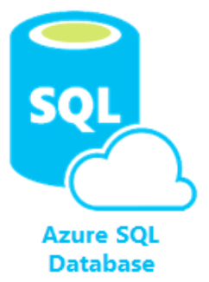
Contained Databases
A platform where all the necessities for authentication and system objects are stored in the user database…
No system databases needed, so the database is easily portable between servers…
What does this sound like?
Azure SQL Database!
Image: https://docs.microsoft.com/en-us/azure/azure-sql/database/media/sql-database-paas-overview/architecture.png
Notes:
<read slide first>
This is the whole purpose of a contained database – unlimited portability on the back end, where Microsoft can move the database from instance to instance inside Azure without having any ties to the instance, everything is contained inside the database, including authentication. You don’t know or care what SQL instance your Azure SQL DB lives on, it’s completely contained and portable.
Microsoft developed this for Azure, then brought the contained database feature to SQL Server, where it’s actually labeled partially contained because of some minor details.
Now this isn’t a presentation about Azure SQL Database, but let’s talk about how the authentication and security principals here are different.

Slide 39
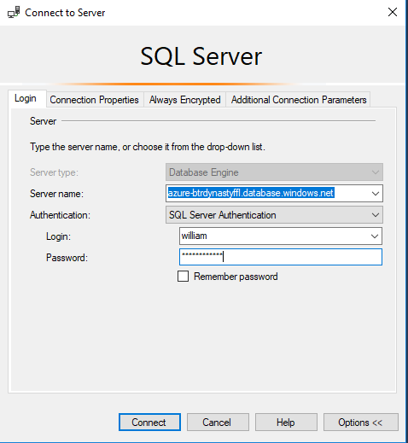
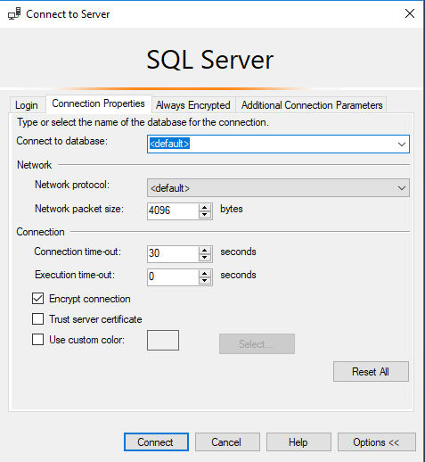
Azure SQL DB Authentication
Only real caveat when connecting to an Azure SQL DB: You youths can’t use USE, you must set the context at login.
Notes:
So get used to specifying the database connection in whatever application you’re making a connection with.

Slide 40
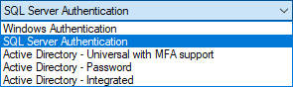
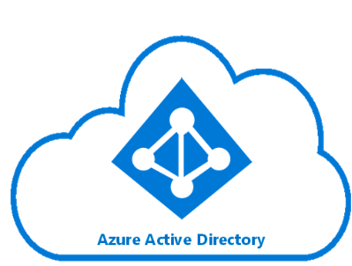
Azure SQL DB Authentication
Additional types of authentication since SSMS 2016
Image: https://docs.microsoft.com/en-us/azure/active-directory/hybrid/media/tutorial-federation/diagram.png
Notes:
The “Active Directory” dash options used for Azure AD only as replacement for the Windows Authentication option. You can of course use SQL Auth for an Azure SQL Database, and that’s really your only option for environment without an integrated Azure AD. For all the same reasons as Windows Authentication for SQL Server, using the Azure AD authentication in Azure SQL DB is superior.

Slide 41
Azure SQL Admin Logins
Azure SQL DB Servers are logical servers only.
Azure SQL Logins in master can be shared across databases.
You initially create one full admin SQL Authenticated login per Azure SQL database logical server.
You can create one Azure Active Directory administrator account with full administrative permissions as well.
You must maintain logins on each Azure SQL logical server in active geo-replication or auto-failover groups.
Notes:
<read notes instead>
Azure SQL DB Servers are logical servers only. The “master” database you see can only store certain objects.
<click>
Azure SQL Logins in master can be shared across databases, if you choose to create multiple Azure SQL databases in the same logical server.
And I say logical server because in Azure SQL DB, all the databases are contained, and behind the scenes, they may
Initially, the SQL authenticated server login account that you specify upon creating an Azure SQL DB exists as a user with administrative rights to all databases on the server.
<click>
That’s the only full admin login on the logical server that uses SQL Authentication, and you can’t create another.
<click>
You can create a second full administrator, this time using Azure Active Directory. Just like in SQL Server, it can be created for an Azure Active Directory individual account or a security group, with a security group preferred.
<click>
In Azure SQL DB, you can have logins in the master database, but more commonly you’ll have contained users in each database.
And while this is the pattern you use for a SQL Server instance, in Azure SQL Databases in active geo-replication or auto-failover groups, there’s that complexity of needing to maintain the Azure SQL DB logins on each server. Just like you would need to create and maintain the logins on each SQL Server of an availability group.

Slide 42
Azure SQL Admin Logins
You can treat Azure SQL just like SQL Server, if you want.
Contained database users can auth via SQL or Azure AD.
You must maintain logins on each Azure SQL logical server in active geo-replication or auto-failover groups.
Notes:
<read notes>
In Azure SQL DB, you can have logins in the master database, and then create non-contained users for those logins in each user database. Just like on SQL Server.
However, it’s common to have you’ll have contained users in each database, and because of the portability of the databases, rely only on contained users in each database for authentication.
<click>
Contained database users can be authenticated via SQL Authentication or via Azure AD Authentication.
<click>
If you choose to create logins in the master database and users for those logins, you get a similar complication when it comes to Azure SQL Databases in active geo-replication or auto-failover groups. If you’re not using contained users, there’s that complexity of needing to maintain the Azure SQL DB logins on each server in the group. Just like you would need to create and maintain the logins on each SQL Server of an availability group.

Slide 43
Azure SQL DB + Azure AD
You can use Azure Active Directory accounts only for Azure SQL contained database users, but not for Azure SQL server logins. Example:
CREATE USER [reportuser@domainname.onmicrosoft.com] FROM EXTERNAL PROVIDER; --different from SQL Server
You must add the Azure AD admin via the Azure Portal first.
Only Active Directory accounts can create other Active Directory accounts in Azure SQL Database.
Notes:
<read slide>
That’s really the only complication, and it’s one you’ll probably forget sooner or later. Only in Azure SQL DB, you have to be logged in with an Azure AD Account to create logins or contained users for other Azure AD Accounts.

Slide 44
Common Security Platform
Otherwise, most permissions, objects, schema, and authentication operate the same on Azure SQL Database, Azure SQL Managed Instance (MI), Azure Synapse Analytics (formerly SQL Data Warehouse), SQL Server, and SQL Server on Linux.
Notes:
<read
In this presentation when we’re talking about permissions, stored procs, views, functions, it’s probably going to be the same for any platform. Azure SQL DB and Synapse are going to have some security specific differences, we’re not going to go into them in detail, but they’re well documented.
Now, speaking of the different platforms, let’s talk a bit about how we connect to them.

Slide 45
Connection Providers
OLEDB was un-deprecated, re-released in ‘18. https://blogs.msdn.microsoft.com/sqlnativeclient/2017/10/06/announcing-the-new-release-of-ole-db-driver-for-sql-server/
Install and Convert your OLEDB connection strings from sqlncli11 or sqloledb, to the new MSOLEDBSQL.
There is also a relatively new ODBC Driver 17 for SQL Server. https://techcommunity.microsoft.com/t5/SQL-Server/ODBC-Driver-17-for-SQL-Server-Released/ba-p/385825
Both replace the OLEDB/ODBC functionality of the SQL Native Client (SNAC) which is no longer maintained.
Important to update sqlncli10 for availability groups
https://www.sqltact.com/2019/06/actual-emails-will-msoledb-work-for.html
Notes:
<read notes>
A little bit on the current state of connection providers. You might have heard that OLEDB was dead, well, long live OLEDB, it’s now a first class provider again via the new MSOLEDBSQL provider.
<click>
There’s also a relatively new ODBC driver for SQL released by Microsoft.
<click>
Both replace the OLEDB/ODBC functionality of the SQL Native Client (SNAC) which is no longer maintained. I’m talking about SNACK 10 and SNACK 11 here, avoid using those for new development, and you’ll probably have no problem switching from either to the new MSOLEDBSQL provider.
<click>
Note that for the SNACK10, which we released with SQL 2008, doesn’t have the parameters needed for successful connections to availability groups, and so that can be a hurdle to overcome for applications to start connecting to SQL Servers that have been migrated to availability groups.
Again if you have any questions, please use the Audience Response System to ask and I’ll do my best to answer after the session.
Ok, this is a security presentation, enough about authentication, let’s talk permissions inside the server and inside the database.

Slide 46
Section Title 3
Permissions

Slide 47
Basic User Permissions
DML*
DDL**
Modify Security
SELECT
DELETE
UPDATE
INSERT
REFERENCES
*Data Manipulation Language
ALTER
CONTROL
VIEW DEFINITION
CREATE
DROP
EXECUTE **Data Definition Language
GRANT
REVOKE
DENY
IMPERSONATE
Notes:
Some basic permissions broken down here into three categories, some of these you’re probably already familiar with.

Slide 48
Common Permissions for Non-Sysadmins
ALTER TRACE For SQL Profiler and traces
ALTER ANY EVENT SESSION For XEvents (replaces traces!)
VIEW SERVER STATE For server DMV’s, XEvents
VIEW DATABASE STATE For database-level DMV’s
VIEW ANY DEFINITION For definitions of objects
GRANT VIEW SERVER STATE TO [SPARK\william.assaf];
_____________________________________________________
GRANT VIEW SERVER STATE TO [SPARK\DBA_team];
Notes:
<read slide>
Example:
These permissions are given by the GRANT syntax GRANT VIEW SERVER STATE TO [SPARK\william.assaf];
Except remember, I shouldn’t be granting permissions to any one individual, I should be granting permissions to a team!

Slide 49
Sample Permissions Scenario
GRANT SELECT ON game.PingPongScore TO [DOM\a_Gump];
GRANT EXECUTE ON game.GetScore TO [DOM\a_Gump];
GRANT EXECUTE TO [DOM\a_Gump]; --in current db context
GRANT VIEW DEFINITION ON game.GetScore TO [DOM\a_Gump];
GRANT ALTER ANY EVENT SESSION TO [DOM\a_Gump];
GRANT VIEW SERVER STATE TO [DOM\a_Gump];
Notes:
<read slide first>
And then of course because this is in production and I’m a responsible DBA, I would have scripted this all out, changed all the GRANTs to REVOKEs, and removed all those excess temporary permissions.
One more detail, I have been granting these permissions to developer Gump’s admin account. Different enterprises use different naming conventions for their admin accounts vs their day to day accounts, it doesn’t really matter to me, but what does matter is that most IT staff have two accounts, one for day to day access, one for admin access. Let’s talk about that more.

Slide 50
Admin Accounts vs Day-to-Day Accounts
All Administrators (including DBA’s) should have two accounts: one for day-to-day workstation/email/Teams/intranet access, one for production admin-level access only.
Day-to-day accounts may have Production read-only access to non-sensitive databases, including metadata, job status and history, error logs, SSISDB logs, logging databases, etc.
The same domain accounts that have production access should not have VPN/remote access.
Notes:
<read notes>
This is a security presentation so we have to talk about how we as DBA’s handle our own credentials and access to SQL data.
This isn’t uncommon, many of my clients in my consulting past already have this type of setup in place, but many of them also are lax about admin permissions for day-to-day accounts, or overuse of admin accounts for services, etc.
So here are some rules we need to stick to as professionals. Everyone should have two accounts, in your corporate enterprise Active Directory, and we gotta keep em separated.
<read slide>

Slide 51
Common Permissions for Non-Sysadmins
SHOWPLAN - Viewing execution plan for executable query
IMPERSONATE - Allows testing rights with EXECUTE AS
CONNECT ALL DATABASES - Allows the login to set any database context (USE) but grants no other rights in each database, potentially appropriate for day-to-day accounts
SELECT ALL USER SECURABLES - SELECT from all objects in ALL db’s, potentially appropriate for day-to-day accounts, but probably not – be aware of your regulatory restrictions.
Notes:
Now I just talked about day to day accounts vs admin accounts.

Slide 52
CONTROL Permissions
CONTROL SERVER - Effectively the same as sysadmin. Not for non-admins.*
CONTROL DATABASE - Effectively the same as db_owner. Not for non-admins.*
*One big difference: CONTROL permissions can be affected by DENY, but sysadmin/db_owner cannot.
Let’s demonstrate…
Notes:
<read notes>
So we talked about the sysadmin server role, which is the everything permission, and we talked about the db_owner role in each database, which is the everything permission in each database. These are commonly granted to admins.
Some other permissions you might find useful are the CONTROL permissions. These are most useful if you’re trying to craft a permissions set for an admin that is just short of sysadmin, for example, something that has access to maintain the server but not certain key activities or databases.
<click>
One big difference between the sysadmin or db_owner roles and the CONTROL permissions are that CONTROL permissions can be affected by DENY, but sysadmin/db_owner cannot.
<click>

Slide 53
Testing Permissions with EXECUTE AS
USE [master];
CREATE LOGIN [dom\username] FROM WINDOWS;
GRANT CONTROL SERVER TO [dom\username];
DENY VIEW SERVER STATE TO [dom\username];
EXECUTE AS LOGIN = 'dom\username';
SELECT * FROM sys.dm_exec_cached_plans; --Fails
GO
REVERT; --Reverts the EXECUTE AS
Notes:
Here let’s demonstrate how control permissions can be denied, and also the EXECUTE AS permission I mentioned earlier, for trying out permissions of another user.
That last revert is key here, you need to be careful because in the case of an error, without that last GO before the REVERT, the REVERT won’t execute. I always put a GO before a REVERT to assure that my EXECUTE AS is reverted, even in the case of an error, a non-fatal error of course. In this case of course of our test, we expect the SELECT statement to fail on behalf of the DENY, so we want that REVERT to fire. The REVERT only affects one EXECUTE AS, so always always always script out your revert and put the GO in front of the REVERT.

Slide 54
Testing Permissions with EXECUTE AS
EXECUTE AS makes it possible for you to simulate the permissions of another principal in your current session.
Always follow an EXECUTE AS with a REVERT, which stops impersonation. A REVERT affects only one EXECUTE AS.
During testing, display what principal you are: SELECT ORIGINAL_LOGIN(), CURRENT_USER;
ORIGINAL_LOGIN() The name of the login at time of connection. Will not change even after EXECUTE AS USER or EXECUTE AS LOGIN.
CURRENT_USER. The name of the user you have currently assumed.
Notes:
<read slide>
Current_User is your reality check, your spinning top in Inception, to make sure you know who you current are. If it’s not who you expect it to be, do a REVERT to make sure all your EXECUTE AS commands, which can become nested, are reverted.
Alright, we’ve covered, authentication and permissions, let’s talk about some more advanced security topics, ones that everyone needs to be aware of. Let’s start with SQL Injection.

Slide 55
Section Title 3
Operational Security

Slide 56

Section Title 3
https://xkcd.com/327/

Slide 57
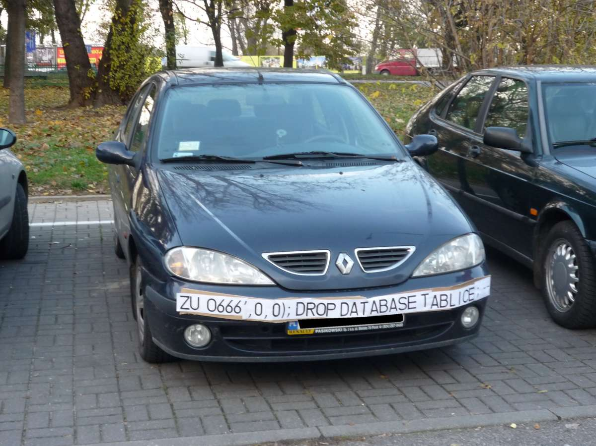



Slide 58
SQL Injection
SQL Server is better than some others but is not immune to SQL Injection attacks made possible by security-ignorant development.
The Basics:
Parameterize the input from the website (use sprocs!)
Sanitize inputs of special characters
Don’t run website SQL logins with more DB permissions than absolutely necessary (again, use sprocs!)
Notes:
<read notes instead>
This is a much larger topic with lots of info out there, I won’t do it justice today, but I will talk about what we as data professionals can do to combat it.
SQL Server is better than some RDBMS platforms but is not immune to SQL Injection attacks made possible by security-ignorant development.
Developers are the ones responsible for preventing or allowing vulnerabilities, and so they must be aware of SQL Injection-blocking patterns on public websites, like
Parameterize the input from the website (use sprocs!)
Sanitize inputs of special characters
Don’t run websites logins with more databases permission than needed (again, use sprocs!) And we’ll talk later about why stored procedures are so important and useful in dealing with security.

Slide 59
What can we do to prevent SQL Injection?
Refuse to give sysadmin or db_owner permissions, demand more specific permissions from vendors.
Design tables with appropriate data types and lengths.
Insist on stored procedures for public-facing operations. Be aware of what db’s have public apps.
Insist on stored procedures for Entity Framework (or other ORMs) operations involving 2+ entities
Notes:
But what can we as data professionals do to prevent SQL Injection, even when we don’t develop or own the applications writing to our database?

Slide 60
What can we do to prevent SQL Injection?
Avoid apps running with permissions like the db_datareader and db_datawriter roles, and certainly not db_owner.
Avoid the use of EXECUTE AS in code, which could allow injected code to execute with elevated security.
Train devs on patterns of stored procedure parameter sanitizing. Never use EXEC() or sp_executesql with user-enterable data.

Slide 61
What can we do to prevent SQL Injection?
Provide links, attention, and visibility to PM’s and Dev’s for SQL Injection awareness.
Lobby for penetration testing and SQL Injection detection tasks in sprints.
With Azure SQL DB, enable Azure Threat Detection!
Notes:
Finally, let’s talk about some more strategic things you can do.
<read slide>
Azure Threat Detection is a security intelligence feature built into the Azure SQL Database, activated with a button click. It uses machine learning to alert you to suspicious activity, like irregular usage times or IP addresses, suspected brute force or injection attacks, and more.

Slide 62
SSMS Vulnerability Assessment Tool
Built into SSMS, there is a Vulnerability Assessment tool available via Object Explorer in each Database -> Tasks.
Introduced in SSMS 17.4 in SQL 2017.
Findings include PUBLIC, GUEST, user-defined roles, low-impact roles, orphaned roles, least privilege, and more.
Notes:
<read notes instead>
What other easy steps can you take to secure your database?
SSMS has a built-in Vulnerability Assessment tool now, introduced a few years ago, and many of its findings are good common sense database-level permissions issues that we’re discussing today, like PUBLIC, GUEST, user-defined roles, low-impact roles, orphaned roles, least privilege, and more.
Ok, we’ve talked about permissions, we’ve talked about some operational or strategic security topics, let’s talk about database permissions and how some important database object types can help make your databases and applications more secure. Let’s start with stored procedures.

Slide 63
Section Title 3
Database Object Security

Slide 64
Stored Procedures
Stored procedures require EXECUTE to run, and do not require underlying permissions (SELECT, INSERT, DELETE), if:
1. the sproc doesn’t perform IDENTITY_INSERT on a table, which requires ALTER permissions not abstracted.
2. all the underlying objects have the same ownership chain.
3. the sproc do not use dynamic sql commands like: exec sp_executesql @SQL or EXEC(@SQL)

Slide 65
Stored Procedures
Given those conditions, thanks to the database permission chain, you could in theory:
GRANT EXEC rights to sprocs that INSERT UPDATE and SELECT from a table.
GRANT no other permissions to the table!
Users can read data from table using sproc ONLY.

Slide 66
Stored Procedures
You could even DENY SELECT to public, which is inherited by all users aside from db_owner and sysadmin.
Users prevented from accessing any objects from any app (SSMS, Access, Excel!).
User access to data is forced through sprocs. (Good!)

Slide 67
Views
Very similar to stored procedures, SELECT permission to query a VIEW will allow a user to SELECT data from table(s) to which the user does not have access.
Notes:
(This is helpful!)
GRANT SELECT ON VIEW is all you’d need, instead of granting access to the underlying tables. In this way you can provide a horizontal or vertically partitioned view of data, excluding certain secure columns for example, or rows. This is a way to essentially perform row-level security.

Slide 68
Row Level Security
SQL 2016+ feature based on inline table-valued functions and a security policy.
Allows to you apply security policy to specific users, filtering specific tables.
Can block reads and writes against tables, without the use of triggers.
Notes:
<read notes>
This is a feature across all platforms, Azure SQL Database, Managed Instance, Azure Synapse Analytics, as well as SQL Server since SQL 2016.
<read slide>
I don’t have a sample lab for this but it’s something you should be aware of when trying to secure data, especially for reporting, but also for environments where databases have a variety of applications developed against them. You may have legacy databases with a mixed security environment of legacy and modern applications, perhaps low-code applications and mobile applications as well, and you want to help developers enforce a single, consistent row-level security policy at the database level. This feature like many others is very well documented with lots of samples on docs.Microsoft.com to help you implement.
https://docs.microsoft.com/en-us/sql/relational-databases/security/row-level-security?view=sql-server-ver15

Slide 69
User-Defined Functions
Similar to views, a UDF will allow a user to SELECT data from tables that the user does not have access to.
Keep in mind the performance impact of functions can be severe, especially in the SELECT portion of a query.
Overuse of UDF’s are common causes for performance issues. High potential for cursor-like effects.
New features in 2017 and 2019 addressed bad performance issues
Notes:
Some of the performance issues with UDF’s were addressed in the last two releases of SQL Server.
In SQL 2017 the performance feature Interleaved Execution helped with performance of Table Value Functions.
In SQL 2019 the new scalar function inlining feature helped reduce the negative performance impact of abused scalar User Defined Functions.

Slide 70
Demonstrate how Stored Procedures, Views, and Functions abstract the permissions necessary to SELECT underlying table data. Toolbox\6 - Security p1.sql – logged in as sysadmin Toolbox\6 - Security p2.sql – logged in as testing user

Slide 71
Section Title 3
Special and Service Accounts

Slide 72
What is “DBO”?
In SQL 2000, sales.dbo.customers meant:
databasename = sales
owner = dbo
tablename = customers
In 2005 and later, sales.dbo.customers meant:
databasename = sales
schema = dbo
tablename = customers

Slide 73
What is a “schema”?
Schema contains database objects.
By default objects are inside the default “dbo” schema.
Additional user schemas can be created. Permissions can be granted to schemas as a set.
Examples:
logical [Staging], [ODS], [Audit], [WH]
business [Sales], [HR], [Acct], [Reporting]
Notes:
A schema is just a securable container, no longer implies “ownership”.
<read slide>

Slide 74
What is “DBO”?
In SQL 2000, dbo was a special user inside each database with sysadmin permissions, which by default owned any object created by an admin.
In SQL 2005 and above, dbo is still a special user that sysadmin logins are mapped to in each database.
Saying a user has “dbo permissions” is incorrect, likely meant [sysadmin] or [db_owner] role membership.
Notes:
<read notes>
Ok, but we really didn’t answer what dbo is.
<read slide>
So since 2005, the special dbo user and the full permissions implied by membership in the [db_owner] role are completely different. Also, let’s talk about “ownership”, because if you’re an old DBA like me, that’s also been redefined.

Slide 75
What is “ownership”?
Microsoft has mostly done away with the terminology of Users or Logins “owning” objects, such as databases and schemas.
Changing the AUTHORIZATION is now the more accurate term to describe “ownership” of an object.
For example, sp_changedbowner is deprecated, replaced by ALTER AUTHORIZATION.
Notes:
<read slide first>
That syntax is for changing the quote owner unquote of a database, which hasn’t been updated in the Management Studio UI, but in the syntax, has been renamed to authorization.
Databases should be owned by service accounts, not interactive accounts.

Slide 76
Interactive vs Service Accounts
Interactive Accounts = used by a human, typed in
Individual day to day accounts, admin accounts
Common accounts (not recommended)
Best to grant permissions to interactive accounts via Roles/Groups
Service Accounts = never typed in by a human
Regular AD Accounts where the password is long and more importantly, not known to anyone outside of a password vault
MSAs, gMSAs, and VSAs

Slide 77
Interactive vs Service Accounts
Appropriate use:
Database owner | Service Account
SQL Agent job owner | Service Account
Schema owner | Service Account
Availability groups owner | Service Account
SQL services service account | Service Account
Application connection strings | Service Account
Notes:
Again, note here that none of these system objects or accounts are appropriate to be owned by an interactive account, that is, your account. If your interactive account expires while you’re in vacation, is locked out maliciously or accidentally, or is disabled when you leave, stuff will probably stop working in fun and exciting ways. You should regularly check to make sure, for example, that you have not become the owners of any databases or jobs you create, including jobs created by Management Studio Maintenance Plans, which have a habit of creating SQL Agent Jobs with your name on them.
Now, one question you probably have, is if the built-in sa account, the SQL Authenticated login that you probably set a password for at install. Does the ‘sa’ account count as an interactive account or a service account? The answer is, it depends on how you use it. I’m OK with databases or jobs being owned by ‘sa’, as long as nobody is using the ‘sa’ account. And ideally, nobody uses the ‘sa’ account. Again, all administrators, even contractors or managed service providers, should be accessing the SQL Server via their personal Active Directory admin accounts. If the ‘sa’ password is painful to enter and not passed around, and only stored in a password vault somewhere, I’m ok with calling ‘sa’ a service account. But if you have old school administrators who like to log in as ‘sa’, then no, we need to fix that behavior, because it’s problematic for reasons we’ve already discussed.

Slide 78
VSA vs MSA (and gMSA)
Virtual Service Account – managed by machine
Examples: [NT SERVICE\MSSQLSERVER], [NT SERVICE\SQLSERVERAGENT]
Managed Service Account – managed by DC
Examples: [Spark\msa_SQLSERVER1$]
PowerShell to install:
Install-ADServiceAccount -Identity "msa_ANF_OSIPIRW“
Group Managed Service Account - gMSA
Notes:
VSA’s are specific to a machine, and for standalone SQL Server instances, they’re perfectly fine and secure to use as the SQL Server or SQL Agent service accounts, for example. They’re installed that way by default unless you specify another service account, and they’re managed by the operating system to simplify the service security. It’s automatically managed, and can even be given access to resources out of the network. Whenever you do that, via a Windows File Share for example, you append a dollar sign to the end of the account, because this is a local computer account.
<click>
However, if you’re configuring an old fashioned Failover Cluster Instance or an availability group, it’s best to configure the SQL Server service account to be a service account managed by the Domain Controller. This can be a standard account you create in AD with a strong password that nobody knows, or, you can use a Managed Service Account. In fact, Microsoft recommends using a Managed Service Account with minimal privileges for any time a SQL Server needs to reach outside its own operating system. Here’s the great thing about MSA’s, they can’t be used interactively. And when you go to provide an MSA to SQL Server Configuration Manager, you just leave the password blank. And MSA’s can only be used on Servers they’ve been configured for, often with PowerShell. For example,
<click>
Once the MSA has been created in Active Directory, this PowerShell here is all that is needed before using an MSA as the Service Account for SQL Server.
<click>
Now, if you want to configure the same Managed Service Account for multiple instances, like in an failover cluster or availability group for example, you can use a Group Managed Service Account, which can be installed and used on multiple servers. Active Directory will automatically and regularly update the gMSA password on each server, quietly and behind the scenes, without any interruptions or outage or restart.
Note that a lot of what I’m talking about is relatively new, in the last few years, on this page may not be available on older operating systems or SQL Server versions. For example, support for gMSA’s was introduced in SQL 2014 and Server 2012 R2, and SQL 2016 is needed for some other scenarios with gMSAs.

Slide 79
BUILTIN\Administrators
Prior to SQL 2008, [BUILTIN\Administrators] was a special object that was member of the server sysadmin role.
This was a security door that did not need to be open – allowing anyone who gained local administrator access to the OS to have sysadmin access.
In SQL 2008+ [BUILTIN\Administrators] no longer has default rights to the SQL server and should NOT be granted access. Do not add it. Actively remove it.

Slide 80
Cross database ownership
A sproc/view can return data from a table in another database without permissions, if the two databases share the same owner login, by enabling Cross-Database Ownership Chaining on both databases.
This is not enabled by default on user databases. It has to be enabled at the server level then activated in each database…

Slide 81
Cross database ownership
Any login can take advantage of Cross-Database Ownership Chaining from another database.
Stored procedures and views – not queries - can then query other databases without any additional permissions.
Which could be very helpful, or a security risk…

Slide 82
Cross database ownership
It is possible that cross-database ownership can bypass your permissions by querying from the context of another database!
Enabling Cross-Database Ownership Chaining increases the necessary complexity of securing your data with minimum permissions.
You probably don’t need it, do it right.

Slide 83
Application roles
By executing sp_setapprole, a user connection inherits the permissions of an app role.
The application role has no permanent members, but is assigned permissions and given an app-only password.
The user connection assumes only the permissions of the application role.
You can utilize Active Directory-based Windows authentication without giving direct permissions.
Can be part of a strategy to force use of database to occur only via the application.

Slide 84
Application roles
Cons:
Accessing other databases requires the use of the guest role.
Connection pooling can be problematic (cookies)

Slide 85
Section Title 3
Wrapup

Slide 86
Continued reading
http://msdn.microsoft.com/en-us/library/ms191291.aspx
https://docs.microsoft.com/en-us/sql/connect/oledb/oledb-driver-for-sql-server?view=sql-server-2017
https://blogs.msdn.microsoft.com/sqlnativeclient/2017/10/06/announcing-the-new-release-of-ole-db-driver-for-sql-server/
https://techcommunity.microsoft.com/t5/SQL-Server/ODBC-Driver-17-for-SQL-Server-Released/ba-p/385825
http://social.technet.microsoft.com/wiki/cfs-file.ashx/__key/communityserver-wikis-components-files/00-00-00-00-05/5710.Permissions_5F00_Poster_5F00_2008_5F00_R2_5F00_Wiki.pdf
http://msdn.microsoft.com/en-us/library/bb669058(v=VS.110).aspx
http://blogs.msdn.com/b/sqlsecurity/archive/2011/08/25/database-engine-permission-basics.aspx
http://msdn.microsoft.com/en-us/library/ms191465.aspx
https://docs.microsoft.com/en-us/sql/relational-databases/databases/security-best-practices-with-contained-databases?view=sql-server-2017
https://azure.microsoft.com/en-us/blog/azure-sql-database-threat-detection-your-built-in-security-expert/
https://www.slideshare.net/GrantFritchey/sql-injection-what-it-is-how-to-stop-it
http://technet.microsoft.com/en-us/library/ms187359.aspx
http://support.microsoft.com/kb/918992
https://azure.microsoft.com/en-us/documentation/articles/sql-database-aad-authentication/
https://azure.microsoft.com/en-us/documentation/articles/sql-database-manage-logins/
https://docs.microsoft.com/en-us/dotnet/framework/data/adonet/sql/server-and-database-roles-in-sql-server/
https://docs.microsoft.com/en-us/sql/relational-databases/security/row-level-security?view=sql-server-ver15
https://docs.microsoft.com/en-us/sql/database-engine/configure-windows/configure-windows-service-accounts-and-permissions?view=sql-server-ver15

Slide 87

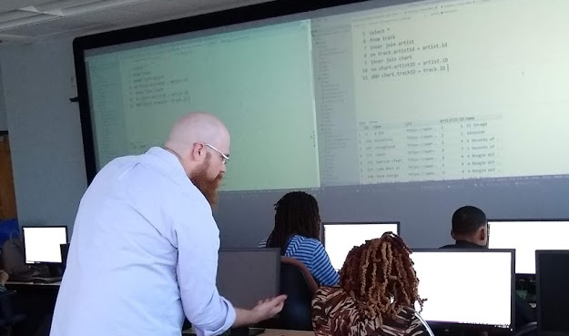
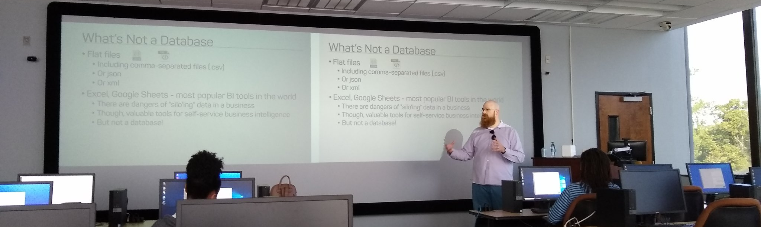
Support your Local STEM Initiatives
https://www.thewallsproject.org/programs/futures_fund/
Notes:
I encourage you to find, then donate time and money to local STEM education initiatives where you live. Get involved in the nonprofits doing STEM education local to you, I’m sure you’re out there, last year I ran for the PASS board on a platform of trying to help PASS activate its membership to get more involved in partnering with local STEM nonprofits especially those in underserved public schools. There is almost certainly some nonprofit where you live that needs your enthusiasm and skills to close the opportunity gap.
Here’s a nonprofit in Baton Rouge that’s special to me, The Futures Fund, which provides Saturday school training to underprivileged youth on web development and digital art and photography.

Slide 88
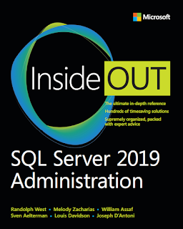
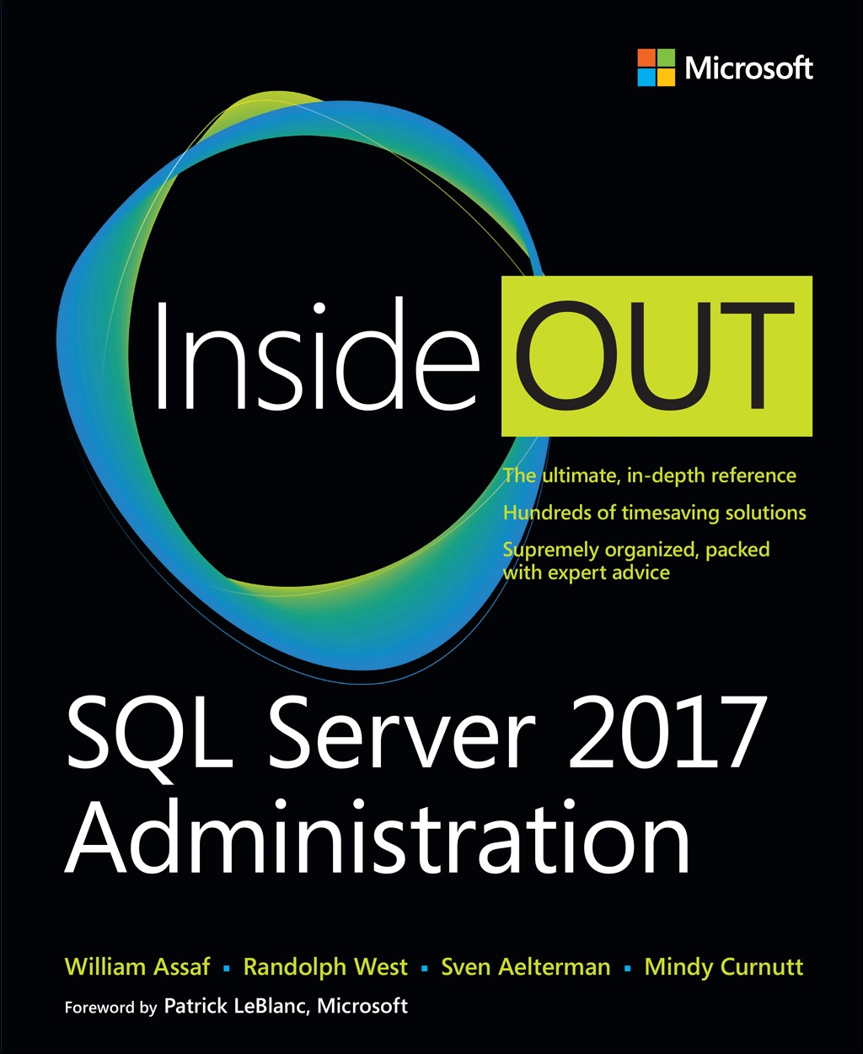
SQL Server 2017 Inside Out
SQL Server 2019 Administration Inside Out
by Microsoft Press
2017 published Feb 2018
2019 coming March 2020

Slide 89
William Assaf
Principal Consultant, Microsoft MVP, PASS Regional Mentor
He/Him
Title
Company
in/williamdassaf
@william_a_dba
SQLTact.com
Co-author, Microsoft Press, SQL Server Administration Inside Out 2017, 2019

